Slide 1
13.7 Cross-validation via Early Stopping

Slide 2
Being highly parameterized, the optimization of cost functions associated with fully connected neural networks, particularly those employing many hidden layers, can require significant computation.
Because of this, early stopping based regularization is a popular cross-validation technique when employing fully connected multi-layer networks.
As described in Section 11.6.2 of the book, early stopping involves learning parameters to minimize validation error during a single run of optimization.

Slide 3
Example: Early stopping on a toy regression dataset

Slide 4
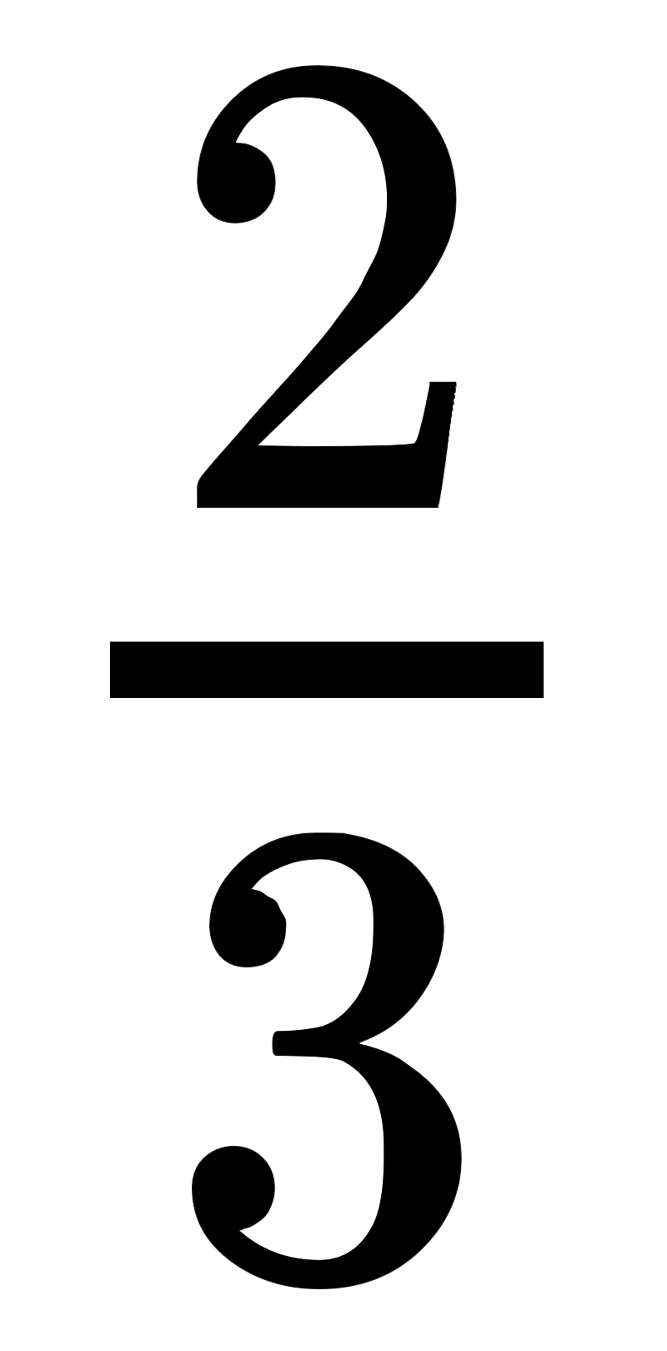

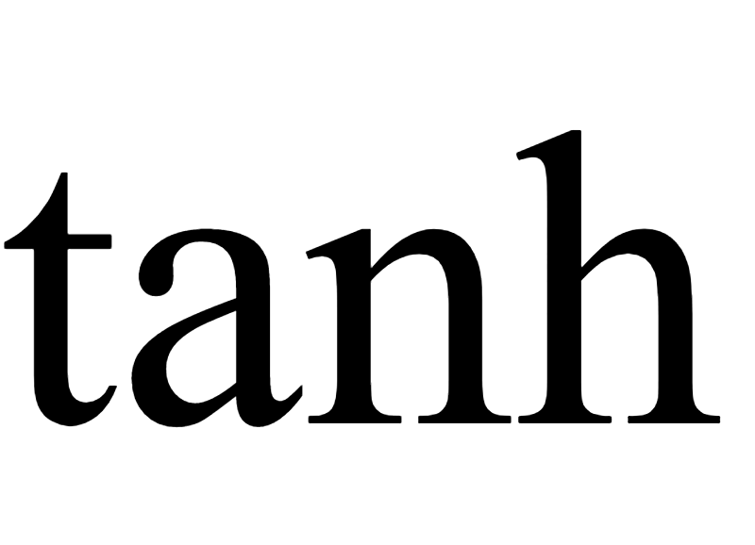
Below we illustrate the early stopping procedure using:
a simple nonlinear regression dataset (split into training and validation)
a three-hidden-layer network with 10 units per layer and the activation
a single run of gradient descent consisting of 20000 steps
Identify at what step we could have stopped the optimization procedure.

Slide 5
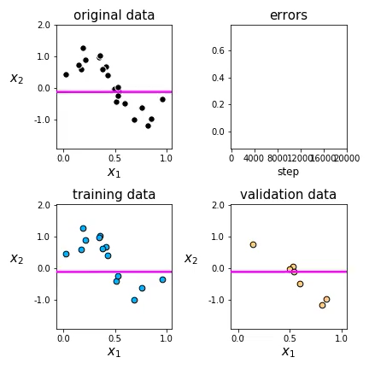

Slide 6
Example: Early stopping on a toy classification dataset

Slide 7
Below we illustrate the early stopping procedure using:
a simple nonlinear classification dataset
a single-hidden-layer network with 5 units per layer and the activation
a single run of gradient descent consisting of 2000 steps
Identify at what step we could have stopped the optimization procedure.

Slide 8
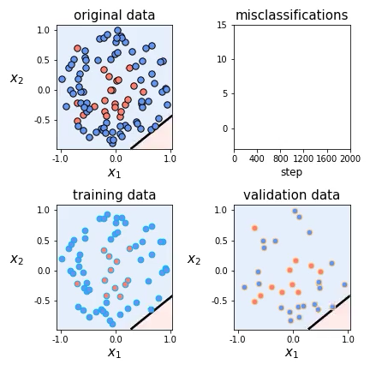

Slide 9
Example: Early stopping on a subset of MNIST

Slide 10
Below we illustrate the cost and misclassification histories using:
a subset of P = 10,000 points from the MNIST dataset
a three-hidden-layer architecture with 10 units per layer and the `ReLU` activation function
a single run of gradient descent consisting of 3,000 steps
Identify at what step we could have stopped the optimization procedure.

Slide 11
